Slide 1



Summary

Slide 2
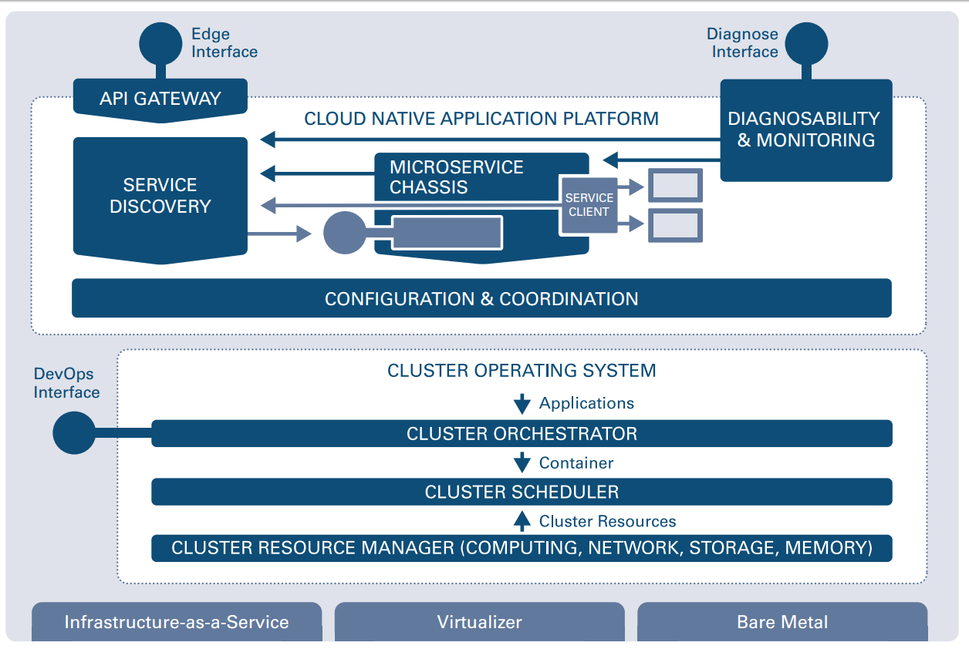
How to provide cluster-wide configuration and consensus?
How to access endpoints from the outside?
How to detect and resolve operational anomalies?
How to expose and find endpoints?
How to call other endpoints resilient and responsive?
How to execute an ops component?
How to run (containerized) applications on a cluster? How to automate standard operations procedures?
How to decouple from physical hardware?
How to provide the right resources for container execution? (e.g. for high utilization)

Slide 3
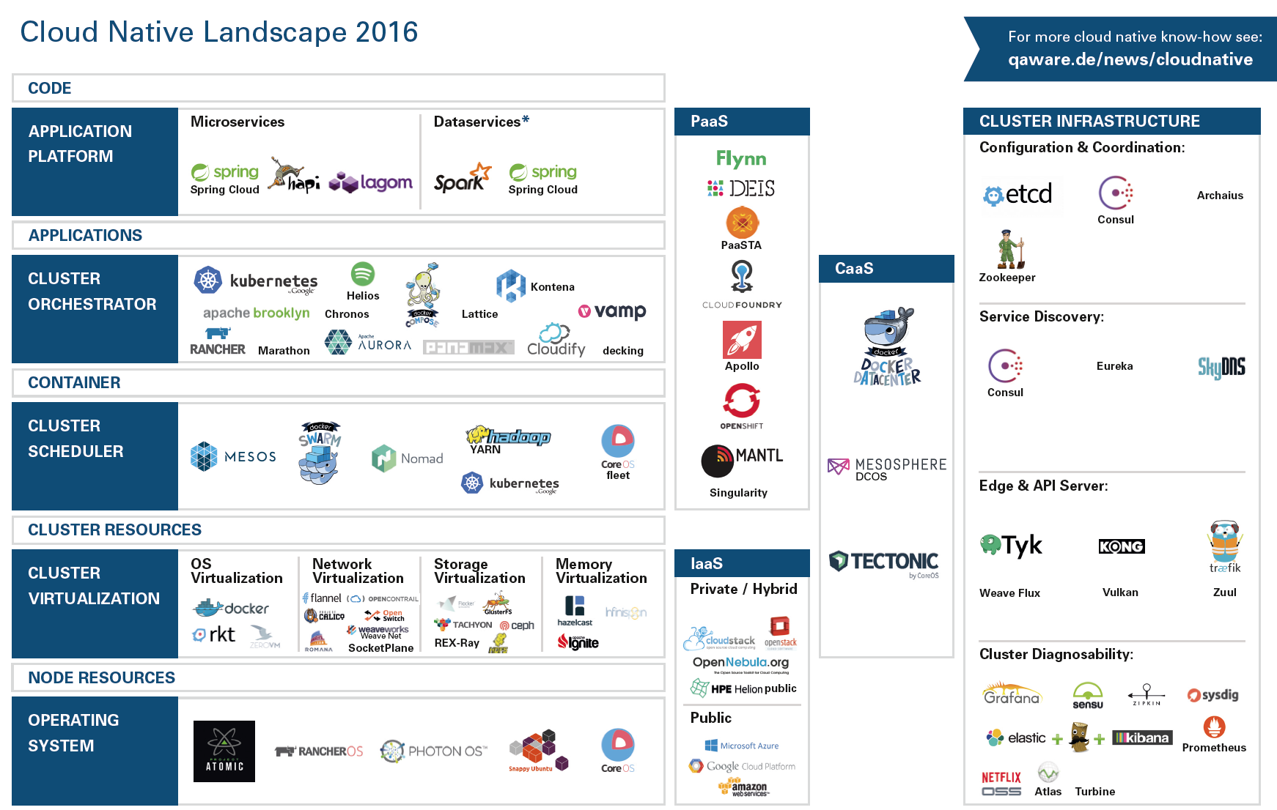

Slide 4
Sneak Preview: Kubernetes
Metadata
Website: http://kubernetes.io
Initiator: Google
In production use at: Pokemon Go, NYT, Google, …
Basic abstractions: Pods, Deployments, ReplicaSets, Service, ConfigMaps, Ingress
How to get a running cluster
Overview: http://kubernetes.io/docs/getting-started-guides
Google Container Engine: https://cloud.google.com/container-engine
Giant Swarm: https://giantswarm.io
Where to start
Kubernetes Docs: http://kubernetes.io/docs
Katacoda Kubernetes Lab: https://www.katacoda.com/courses/kubernetes
DNS-Name
Service
Selector
Port
Port
Port
Deployment
IP
Pod
Container
Replica Sets
Label: <K,V>
Selector
Container
Volume

Slide 5
Sneak Preview: OpenShift v3
Metadata
Website: https://www.openshift.org
Initiator: RedHat
In production use at: ReHat
Basic abstractions: Kubernetes abstractions + Route, ImageStream, Build, Template
How to get a running cluster
Private cluster: https://docs.openshift.org/latest/getting_started/ administrators.html
Public cluster: https://www.openshift.com/devpreview
Where to start
https://docs.openshift.org
https://www.openshift.com/promotions/ebook.html

Slide 6
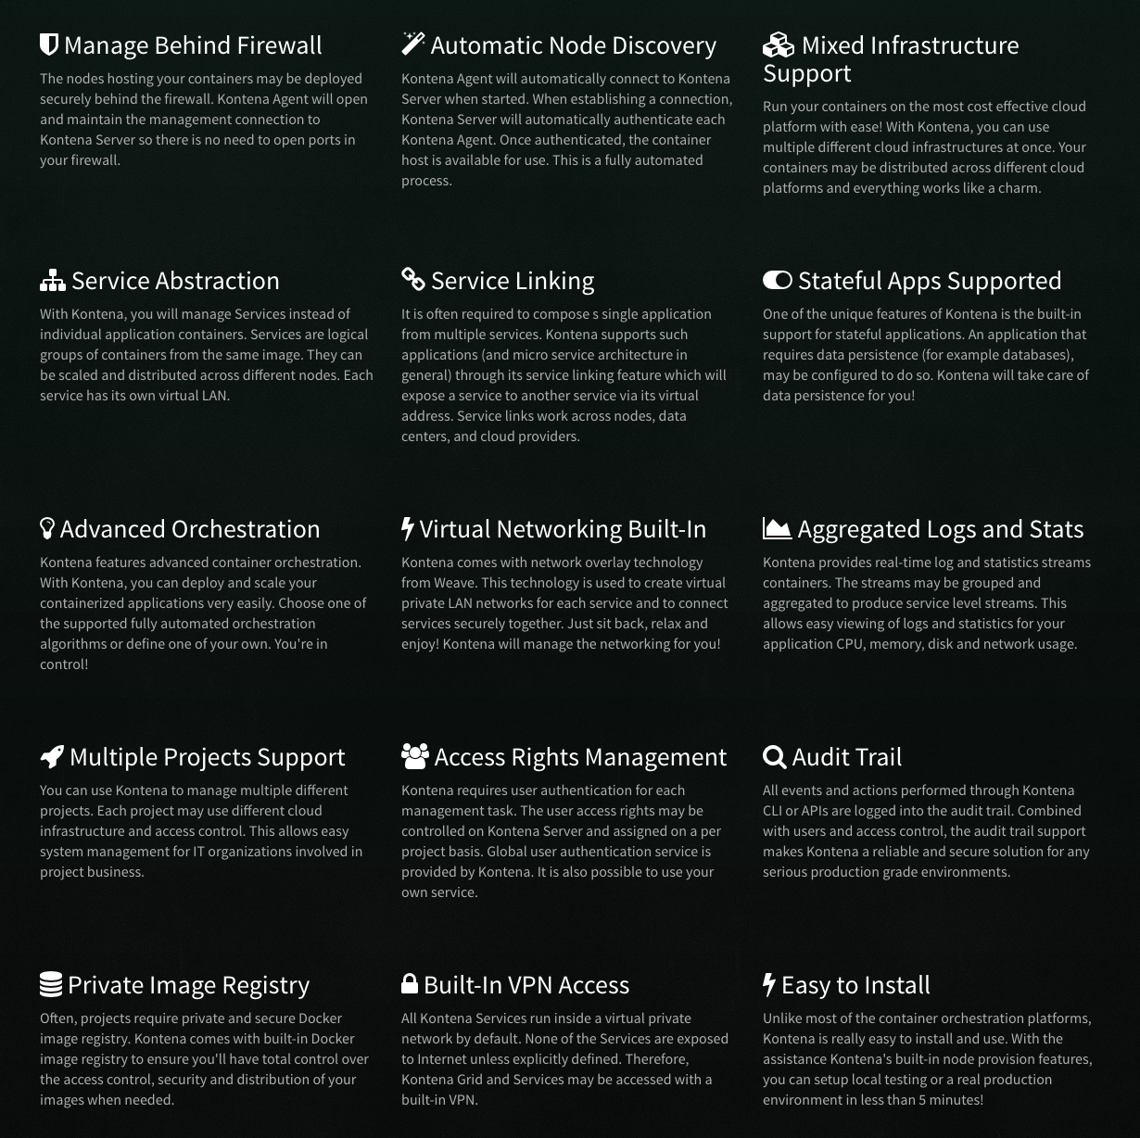
Sneak Preview: Kontena
Metadata
Website: https://kontena.io
Initiator: Kontena, Inc.
In production use at: ?
Basic abstractions: LoadBalancer, Application, Service, Grid.
How to get a running cluster
https://www.kontena.io/docs/ getting-started/installing/
Where to start
https://kontena.io/platform
https://www.kontena.io/docs

Slide 7

Play hard!

